Slide 1


Slide 2
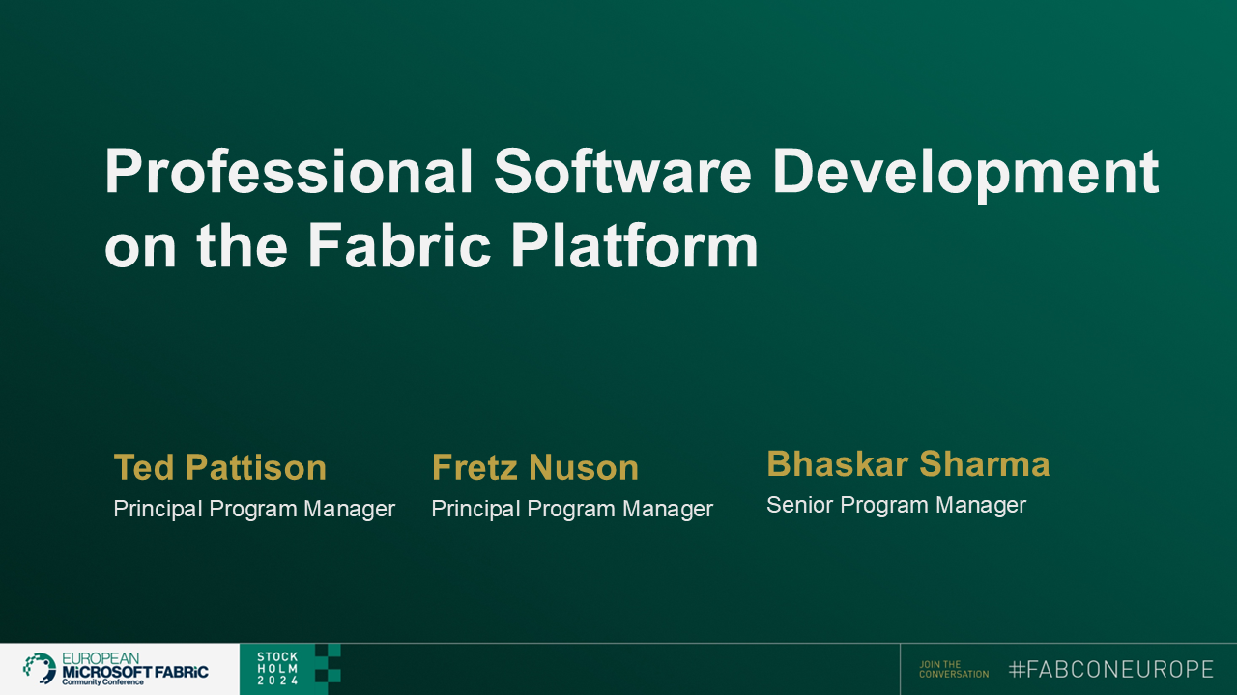

Slide 3
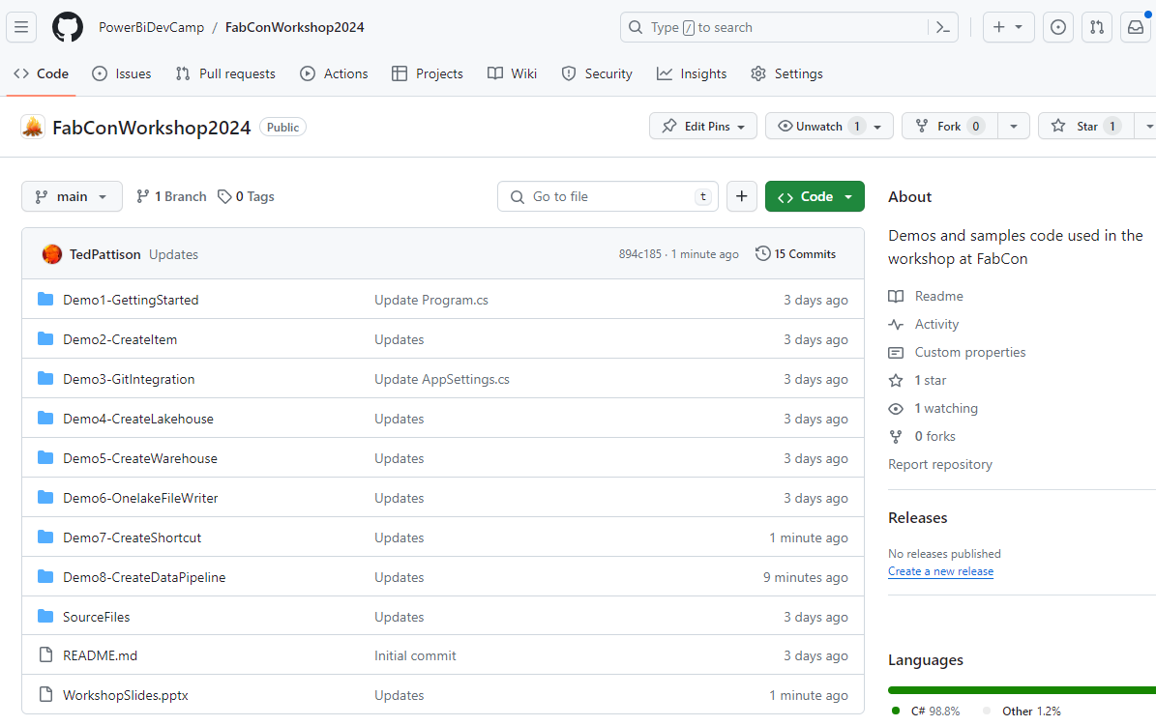
Downloads and Materials for This Workshop
All workshop materials available online on a GitHub repository
Download from https://github.com/PowerBiDevCamp/FabConWorkshopSweden
Material contains eight developer sample projects created as C# console applications with .NET 8
Material contains workshop slides
Quick Links to Workshop Material
GitHub: https://aka.ms/FabConWorkshop
Slides: https://aka.ms/FabConWorkshopSlides
Download: https://aka.ms/FabConWorkshopDownload
Edits Required
slides

Slide 4
Student Survey
What Languages?
JavaScript or TypeScript
C# or VB.NET
Python
Java
What else?
What development platforms?
Angular
React
.NET
Java
Node.js
Salesforce
What else?

Slide 5
Workshop Agenda
Solution Deployment using the Fabric REST API
Automating Solution Deployment across Fabric Workloads
Getting Started with the Fabric CI/CD
Fabric Data Warehouse CI/CD using IDE

Slide 6





Deploying Fabric Solutions in Multi-tenant Applications
Multi-tenant application is responsible for creating and managing customer tenants
Customer tenant created using one or more Fabric workspaces
Developer uses Fabric REST APIs to create and configure workspace items
Workspace items include lakehouses, notebooks, semantic models and reports
Fabric Multi-tenant Environment
Azure AD Tenant Owned by ISV
Customer 01 Tenant Workspace
Customer 01
17 users
lakehouse
notebook
model
report
Custom ISV Application
Customer 02 Tenant Workspace
lakehouse
notebook
model
report
Customer 02
85 users
Customer N Tenant Workspace
lakehouse
notebook
model
report
Customer N
450 users

Slide 7
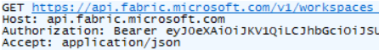
Fabric REST API Design and Architecture
Fabric REST API used to create workspaces and deploy workspace items
Fabric REST API designed to be accessible to any developer on any development platform
Built using principles of REST and open security standards (i.e. OAuth2 and Open ID Connect)
Public cloud endpoint accessible through base URL of https://api.fabric.microsoft.com/v1
Fabric REST API can be called as a [user] or as a [service principal]
Caller must first acquire access token for Fabric REST API from Entra Id Service
Caller must transmit access token in all API calls using Authorization header
Your Application
Fabric REST API
access token
JSON Result
HTTP Response: 200 OK

Slide 8
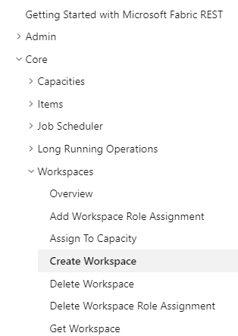
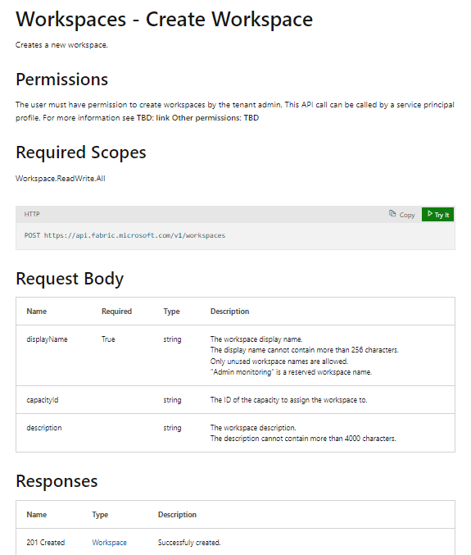
RTFM! = Read The Fabric Documentation
Fabric REST APIs documentation available online is essential developer resource
https://learn.microsoft.com/rest/api/fabric

Slide 9
Authentication and API Caller Identity
Fabric REST API supports executing API calls under two identity types
User principal (UPN)
Service principal (SPN)
Service principals often better choice for custom applications
Eliminates blocking issues with MFA and interactive login requirements
Eliminates dependencies on specific users (e.g. what to do when user leaves organization)
Fabric REST API support for SPNs is still work in progress
Some API endpoints already support SPN, but some do not
SPN support for Fabric REST API being released incrementally throughout 2024
Custom ISV Application
Fabric REST API
Entra Id Tenant Owned by ISV
call as user
UPN
Token
call as service principal
SPN
Token

Slide 10
Executing API Calls as a Service Principal
Two ways to create a service principal for custom application
Create a Custom Application in the Entra Id Service
Create a Managed Identity in Microsoft Azure
Requirements to authenticate as service principal using Entra Id application
Create custom application in Entra Id service and configured it with client secret/certificate
Custom application must pass client secret/certificate to Entra Id Service to authenticate
Entra Id Service returns access token with service principal object Id of custom application
Requirements to authenticate as service principal using managed identity
Create managed identity associated with Azure resource (e.g. Web App, Function App, VM)
Custom application can authenticate and acquire access token with passing client secret/certificate
Entra Id Service returns access token with service principal object Id of managed identity

Slide 11
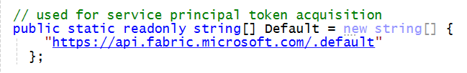
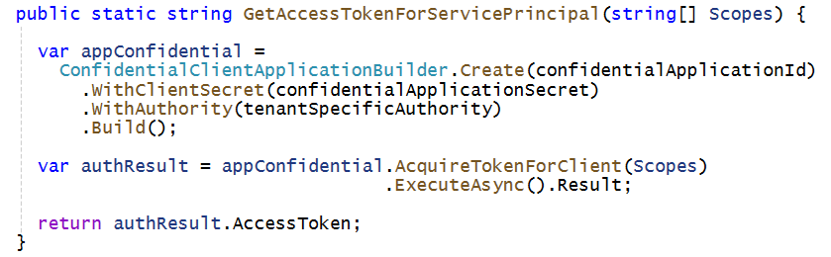
Acquiring Access Tokens for Service Principal using MSAL
When using client credentials flow, pass default permission scope for Fabric REST API
Use default permission scope (.default) when requesting to acquire access token
Acquiring access token with Entra Id application and client secret
Create ConfidentialClientApplication from MSAL
Call AcquireTokenForClient and pass TenantId, ClientId and ClientSecret
More info about MSAL at https://learn.microsoft.com/en-us/entra/identity-platform/msal-overview

Slide 12
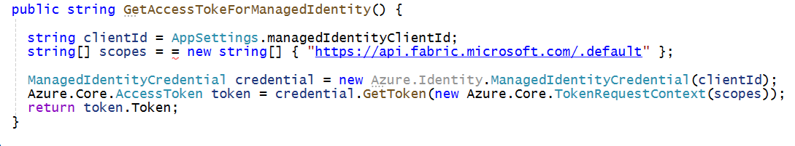
Authenticate as Service Principal using Managed Identity
Microsoft Azure support two different types of manage identities
Azure supports System-assigned Managed Identities and User-assigned Managed Identities
Both types of managed identities can be used to call Fabric REST API
Authenticating as service principal using managed identity
Authenticating with managed identity does not require passing client secret or client certificate
Authenticating with user-assigned managed identity requires passing Client Id
Authenticating with system-assigned managed identity does not require passing Client Id
.NET Developers can leverage Azure.Identity library to implement managed identity authentication flow

Slide 13
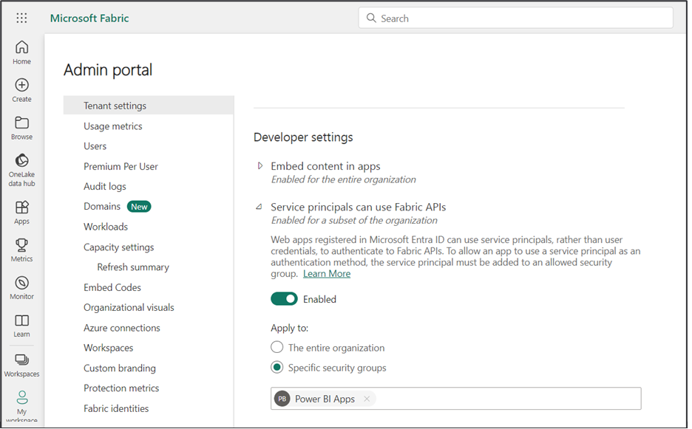
Configuring Service Principal Access to Fabric REST API
Service principals by default have no permissions to call Fabric REST API
Service principals must be configured with tenant-level setting Service Principals can use Fabric REST API
Service principals cannot be added directly to setting in Fabric Admin portal
Add service principals to Entra Id group and then add group to Service Principals can use Fabric REST API
Service principal has no default access to any workspace
Service principal must be added to existing workspace as workspace member to access workspace content
Service principal creating workspaces added to Admin role and has full access automatically
Entra Id Security Group
Entra Id Application
11111111-1111-1111-1111-111111111111
Entra Id Application
22222222-2222-22222-2222-222222222222
Managed Identity
33333333-3333-3333-3333-333333333333
Managed Identity
44444444-4444-4444-4444-444444444444

Slide 14
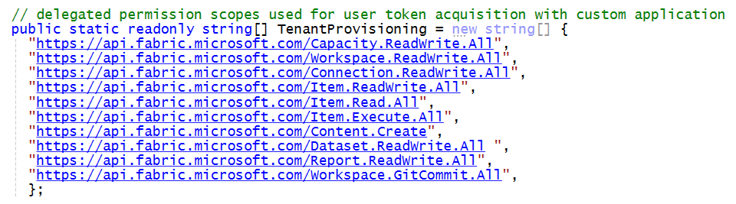
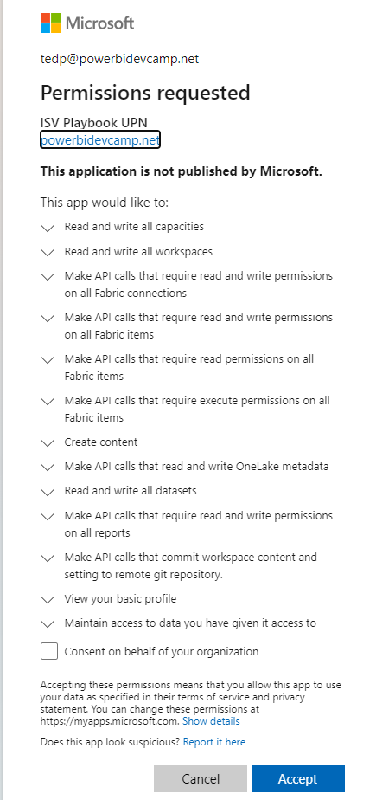
User Authentication and Delegated Permission Scopes
Authenticating as user requires adding delegated permission scopes to access token
Developer passes requested delegated permission scopes to Entra Id Service when acquiring access token
Authentication flow used by Entra Id Service will prompt user to consent to requested permissions

Slide 15
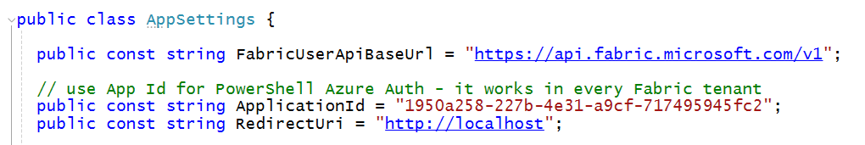
Authenticating with Microsoft Azure PowerShell Application
Azure PowerShell application can simplify development and
Azure PowerShell application in Entra Id application automatically available in all Entra Id tenants
Eliminates the need for creating custom Entra Id application for developer testing and experimentation
Supports all-powerful user_impersonation delegated permission scope in Fabric and Power BI
Use the well-known application ID of 1950a258-227b-4e31-a9cf-717495945fc2
Acquire access token with user_impersonation delegated permission scope
This is handy for developer testing and for desktop tools – but it cannot be used in Web applications

Slide 16
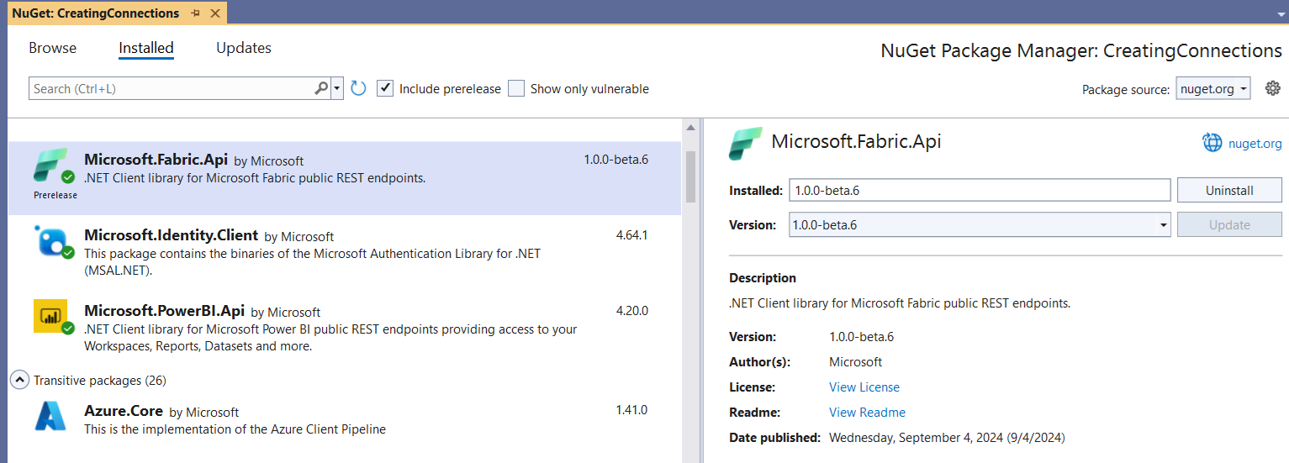
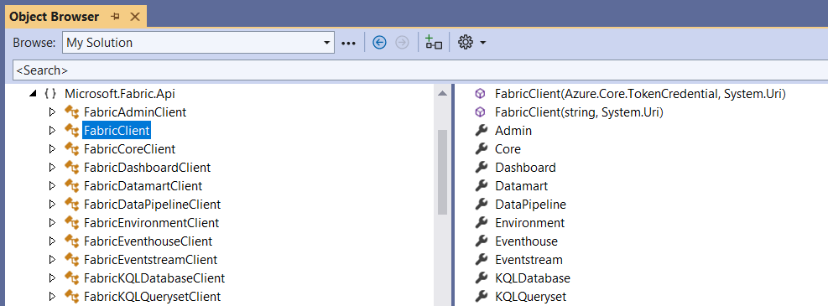
.NET SDK for the Fabric REST API
Fabric REST API .NET SDK currently released under public preview
.NET SDK can be added to .NET projects as NuGet package
.NET SDK provides large number of public classes which act as client wrappers to Fabric REST API endpoints
.NET SDK for Fabric REST API adds valuable productivity boost to C# developers
Abstracts away executing HTTP requests and handling HTTP responses
Handles serializing/deserializing JSON payloads sent back and forth over the wire
Provides automatic support for executing API calls which implement long-running operations (LRO) pattern
Provides automatic support for dealing with continuation tokens and merging paginated results

Slide 17
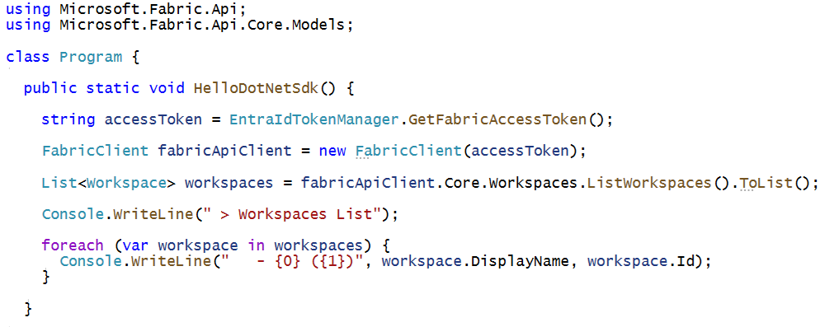
Getting Started with Fabric REST API .NET SDK
Steps to getting started
Acquire access token for Fabric REST API
Initialize instance of the FabricClient class using access token
Execute Fabric REST API calls through item-specific clients (e.g. Core.Workspaces client)

Slide 18
Fabric REST API Item Types
Fabric REST API provides support for platform types and workspace item types
Platform item type instances created within scope of the current Entra Id tenant
Workspace item type instances created within scope of a Fabric workspace
Platform Item Types
Capacity
Workspace
Connection
Workspace Item Types by Workload
Power BI
Data Engineering
Data Warehouse
Data Factory
Real-time Intelligence
Data Science
SemanticModel
Lakehouse
Warehouse
DataPipeline
Eventhouse
MLExperiment
Report
Notebook
MirroredWarehouse
Dataflow
KQLDatabase
MLModel
SparkJobDefinition
KQLQueryset
Shortcut
Eventstream
Environment

Slide 19
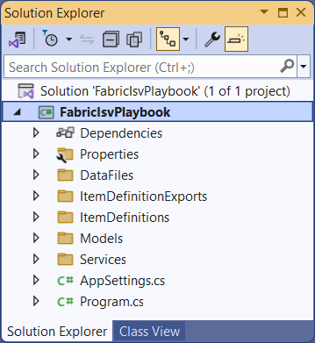
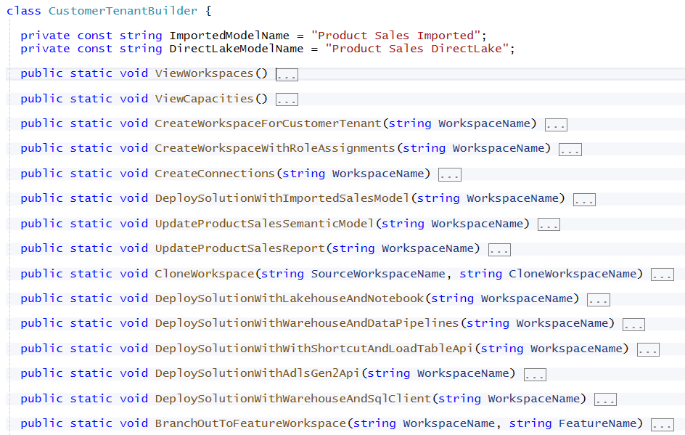
.NET Developer Sample using C# - Fabric-ISV-Playbook
Fabric-ISV-Playbook is a C# console application built with .NET 8
Demonstrates what is possible deploy solutions based on workspace items
Available for download https://github.com/PowerBiDevCamp/Fabric-ISV-Playbook

Slide 20
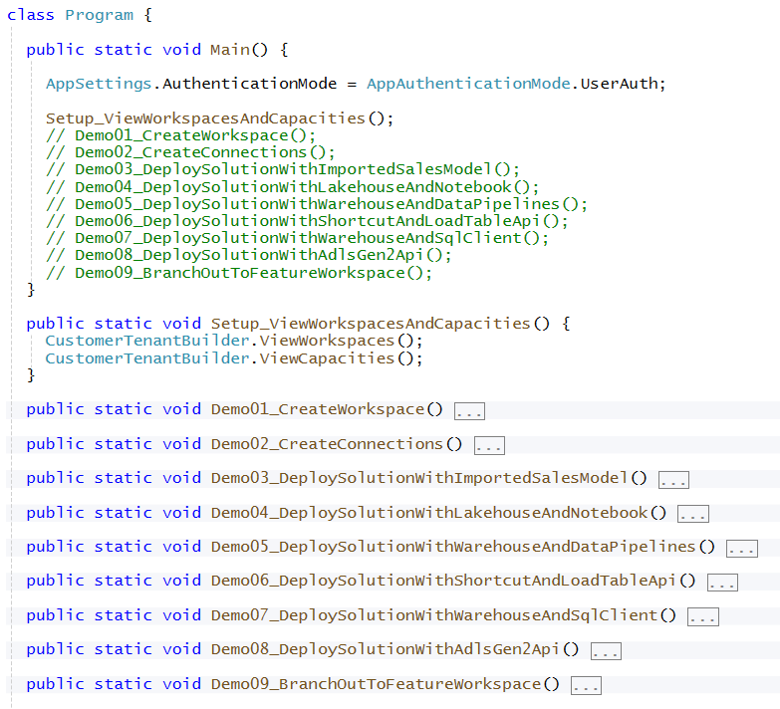
Provisioning Flow Demos from FabricIsvPlaybook
Demonstrations from FabricIsvPlaybook developer sample
Demo01_CreateWorkspace
Demo02_CreateConnections
Demo03_DeploySolutionWithImportedSalesModel
Demo04_DeploySolutionWithLakehouseAndNotebook
Demo05_DeploySolutionWithWarehouseAndDataPipelines
Demo06_DeploySolutionWithShortcutAndLoadTableApi
Demo07_DeploySolutionWithWarehouseAndSqlClient
Demo08_DeploySolutionWithAdlsGen2Api
Demo09_BranchOutToFeatureWorkspace

Slide 21
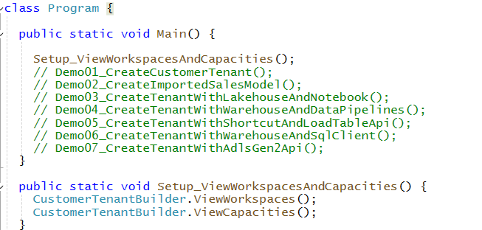
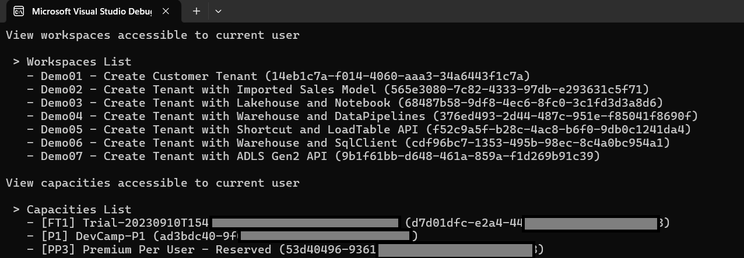
Getting Started with FabricIsvPlaybook Developer Sample
Run to Setup_ViewWorkspacesAndCapacities in program.cs get started
When viewing capacities, you need to find capacity ID for AppSettings.cs

Slide 22
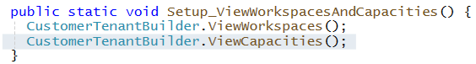
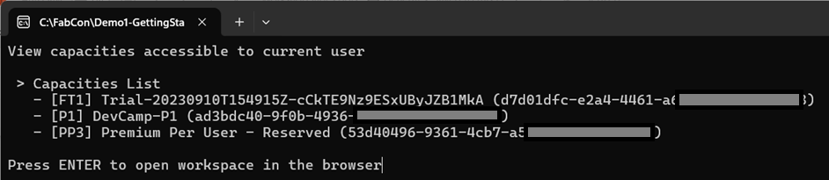
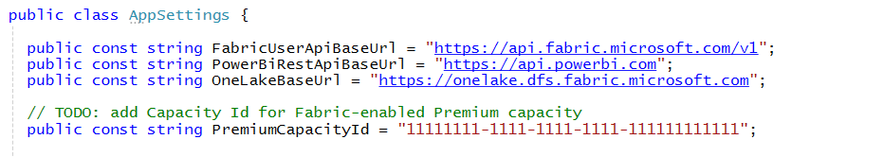
You Need a Premium Capacity Id for Testing
Run Setup_ViewWorkspacesAndCapacities to call CustomerTenantBuilder.ViewCapacities
View list of Premium capacities and copy the Id of one of them
Paste the Id of Premium capacity into PremiumCapacityId constant in AppSettings.cs
Copy and paste Premium capacity Id

Slide 23
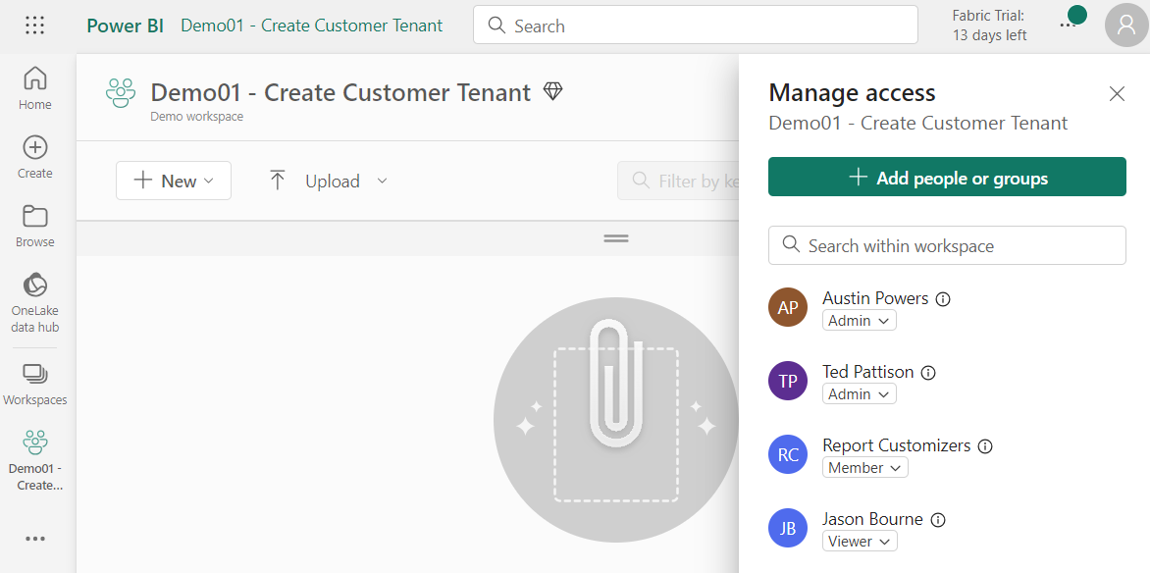
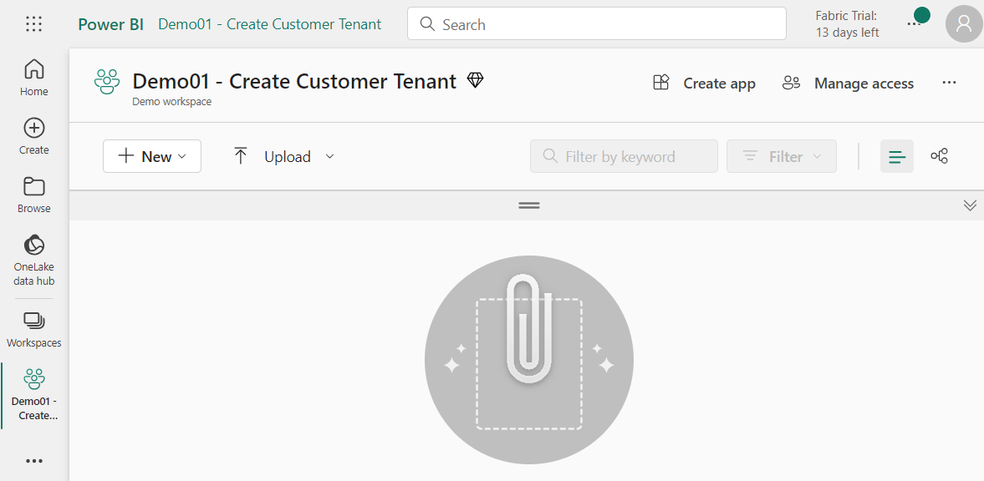
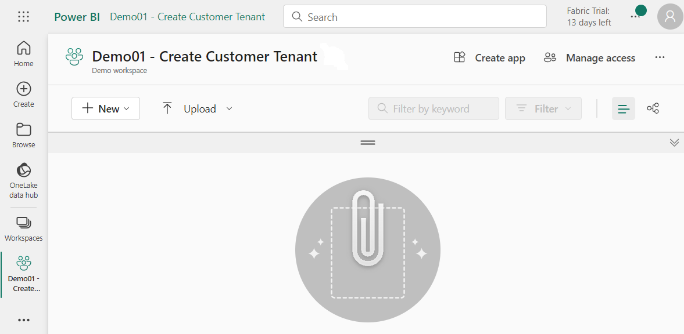
Demo 1 – Create Workspace and Assign Workspace Roles
Getting started with workspace provisioning
Create workspace (delete any existing workspace with same display name if it exists)
Associate workspace with Fabric-enabled capacity id
Assign workspace roles
Custom ISV Application
Customer Tenant Workspace
Create Workspace
Associate with Capacity Id
Assign Workspace Roles

Slide 24
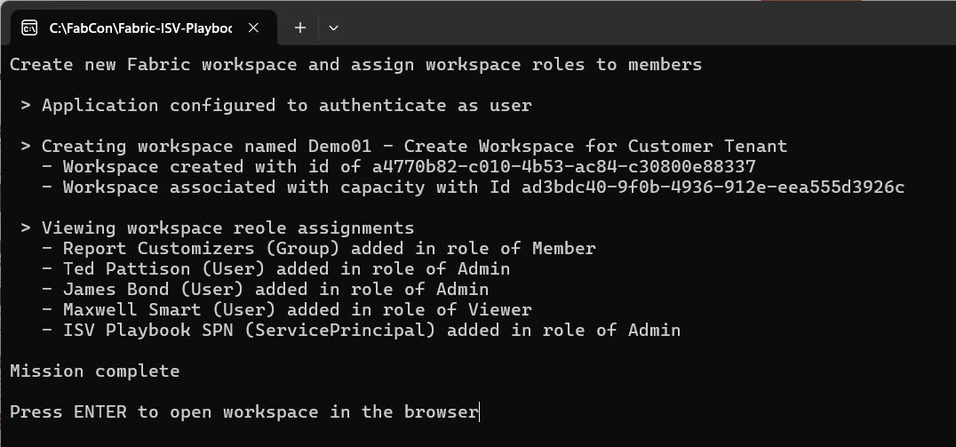
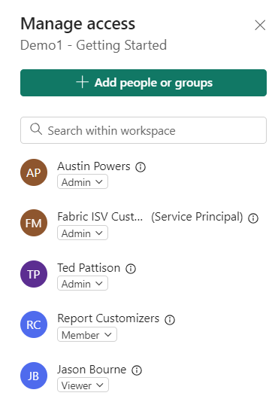
Demo01 Output

Slide 25
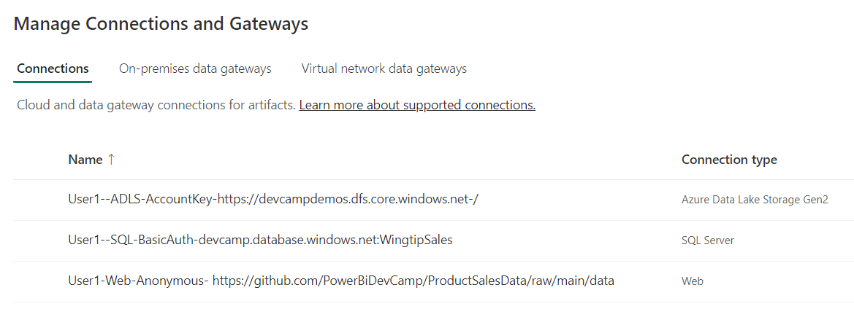
Creating and Managing Connections in Fabric
Connections are scoped at level of Entra Id tenant
Fabric connection can be shared across workspaces – just because you can doesn’t mean that you should
Connection creator automatically configured with connection Role Assignment of Owner
Other users and service principals added with Role Assignments of User, UserWithReshare or Owner
Scenarios which require developers to create connections in Fabric deployment
When deploying OneLake Shortcuts
When deploying Data Pipelines
When deploying Semantic Models

Slide 26
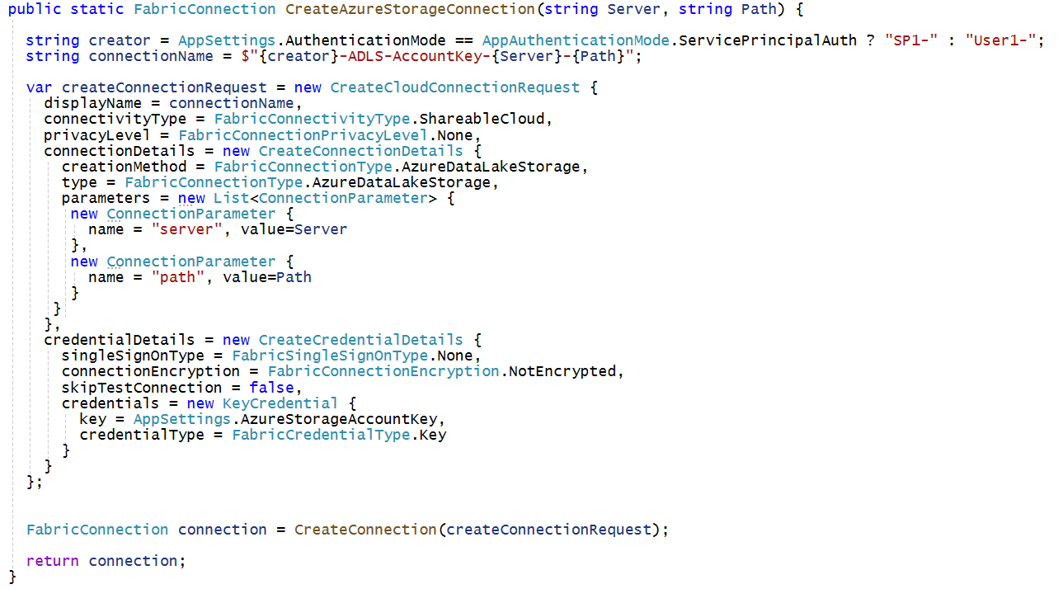
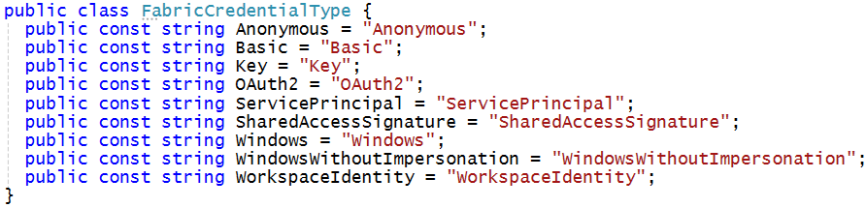
Fabric Connections API
Public Preview of Fabric Connections API released in September 2024 October 2024
Allows developers to create and manage Fabric connections
Allows developers to create 50+ types of connections supported by Fabric
Allows developer to use several different supported types of connection credential

Slide 27
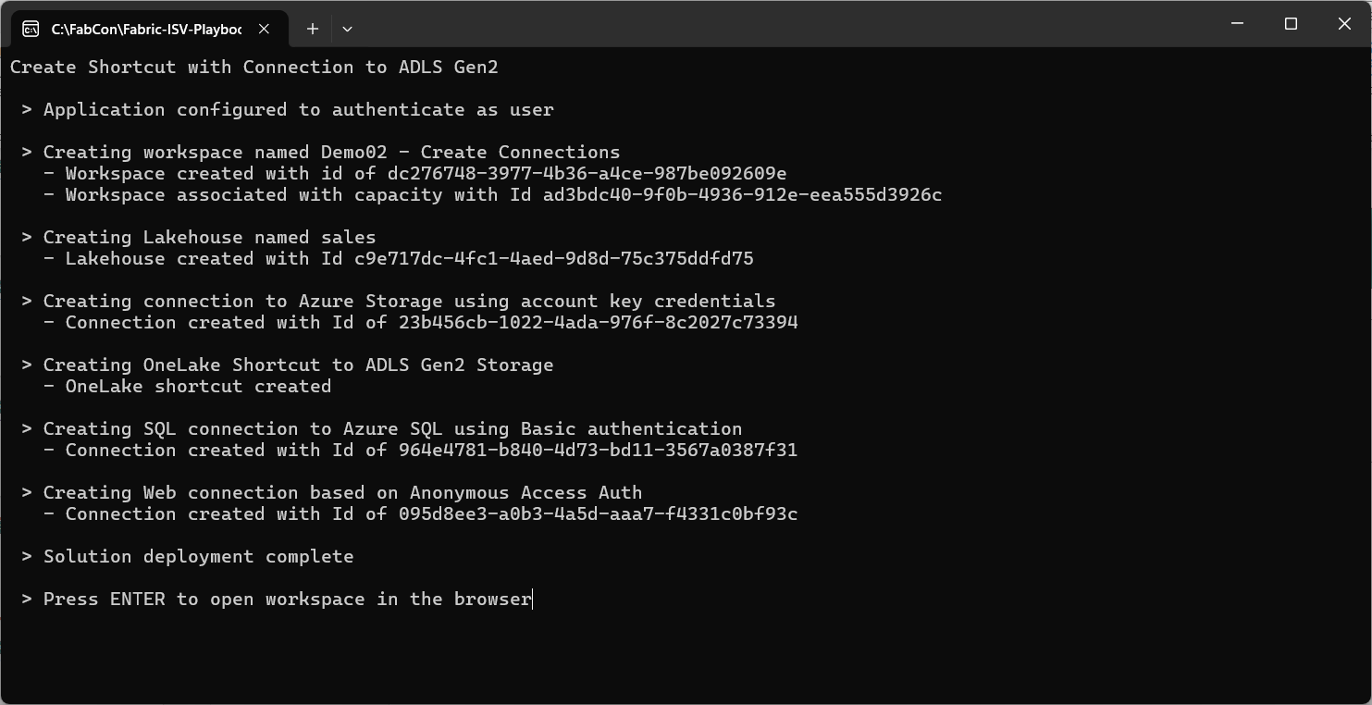
Demo02 Output

Slide 28
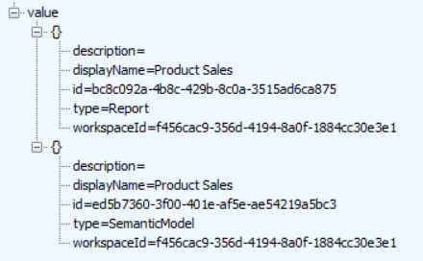
Programming with Workspace Items
Fabric solutions built using workspace items
Developers must learn to discover, create and manage workspace items inside scope of a workspace
Discover what items exist in specific workspace by calling List Items API
Workspace Item Types by Workload
Power BI
Data Engineering
Data Warehouse
Data Factory
Real-time Intelligence
Data Science
SemanticModel
Lakehouse
Warehouse
DataPipeline
Eventhouse
MLExperiment
Report
Notebook
MirroredWarehouse
Dataflow
KQLDatabase
MLModel
SparkJobDefinition
KQLQueryset
Shortcut
Eventstream
Environment
Your Application
Fabric REST APIs
GET https://api.fabric.microsoft.com/v1/workspaces/{WORKSPACE_ID}/items
200 OK

Slide 29
Programming with Fabric Item Definitions
Fabric items can be created and updated using item definitions
You can pass item definition when calling Create Item API
You can retrieve item definition for existing Fabric item by calling Get Item Definition
You can modify existing workspace item by calling Update Item Definition passing item definition
Your Application
Fabric REST APIs
Item
Definition
POST - Create Item
Item
Definition
POST - Get Item Definition
Item
Definition
POST - Update Item Definition

Slide 30
Fabric Item Definition Structure
When calling Create Item, you pass displayName, type and definition
Item definition includes array of parts where each part is item-specific file
File content for parts converted to/from inline base64 format when transmitted across network
Item definition for each item type requires unique set of parts
Creating semantic model definition requires parts for definition.pbism and model.bim
Creating report definition requires parts for definition.pbir, report.json and a report theme file
displayName:
Product Sales
displayName:
Sales by Product
type:
SemanticModel
type:
Report
definition:
definition:
parts: {
}
parts: {
}
definition.pbism
definition.pbir
model.bim
report.json
report-theme.json

Slide 31
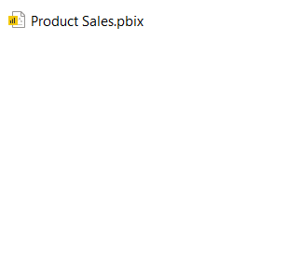
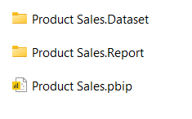
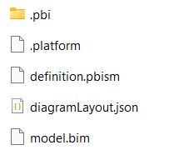
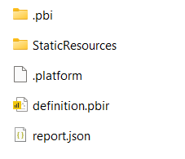
PBIP Projects in Power BI Desktop
Power BI Desktop supports Power BI Desktop Developer Mode (Preview)
Power BI Desktop has traditionally allowed saving projects in PBIX file format
Power BI Desktop now allows saving projects in Power BI Project (PBIP) format
Power BI Desktop saves semantic model definition using model.bim and definition.pbism
Power BI Desktop saves report definition using report.json and definition.pbir
.pbi folder used to store local resources that should not be saved into source control system

Slide 32
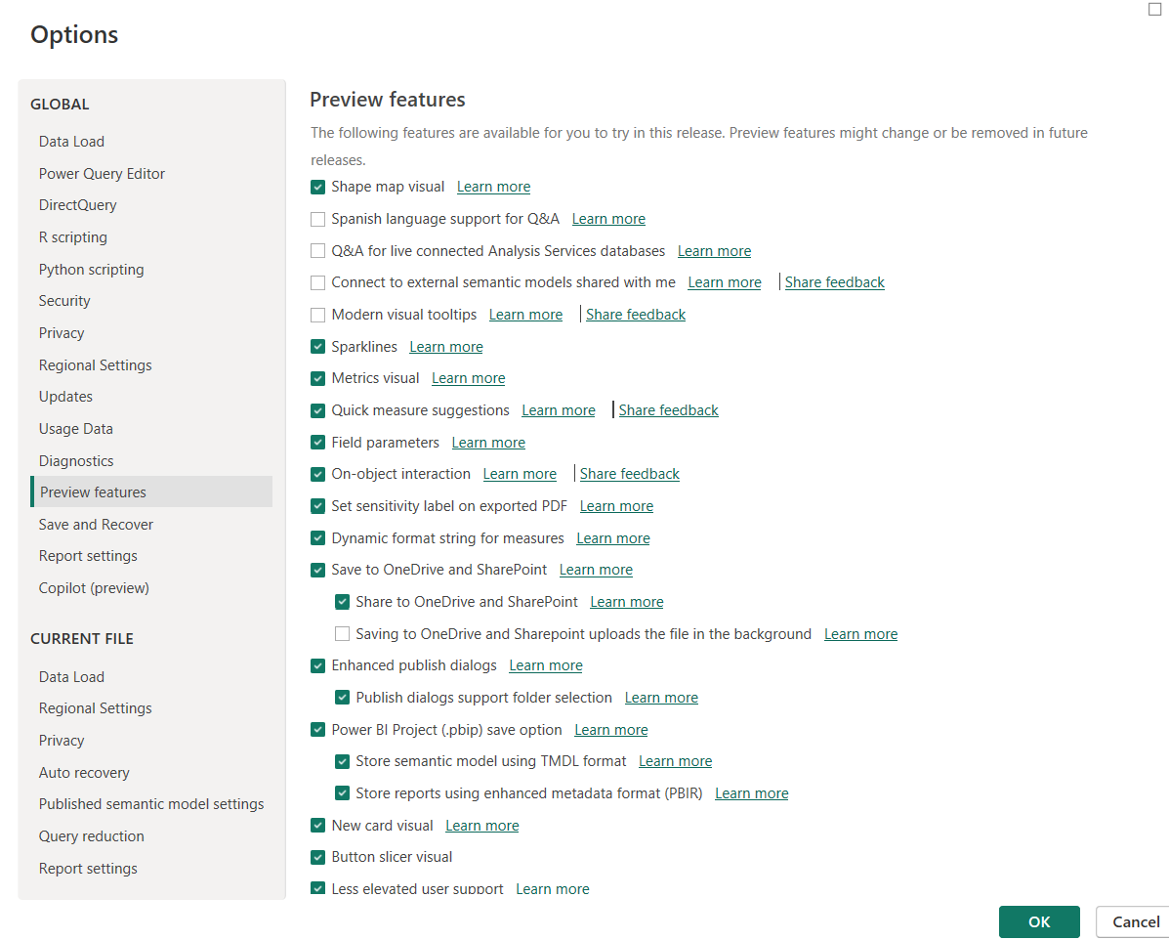
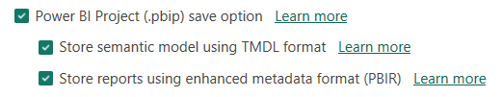
Enabling the Power BI Project (.pbip) Save Option Feature
Enable Power BI Project (.pbip) save option in Power BI Desktop Options dialog
Optionally configure semantic models and reports to use newest definition formats

Slide 33
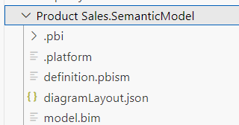
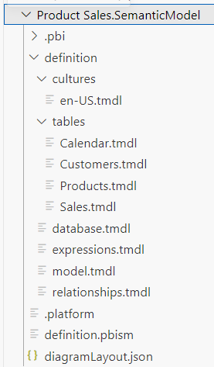
TMSL versus TMDL - Semantic Model Formats
Semantic Model Definitions can be saved in TMSL format or TMDL format
TMSL is simple - a single model.bim file contains entire semantic model definition
TMDL is more granular – better for source control when multiple developers are working on same model
TMSL Format
TMDL Format

Slide 34
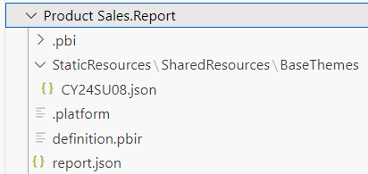
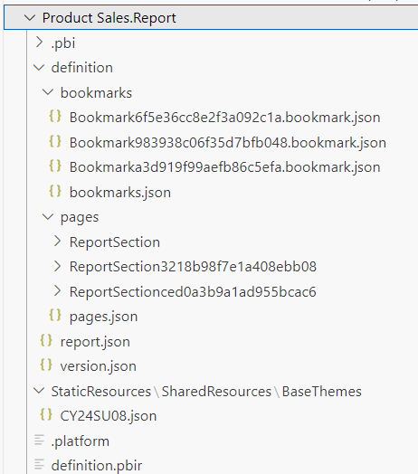
PBIR-Legacy versus PBIR - Report Definition Formats
Report Definitions can be saved in PBIR-Legacy format or PBIR format
PBIR-Legacy is original Power BI report definition format with entire definition stored in report.json file
PBIR is modern, more granular format which allows for editing/creating definitions using JSON schema
PBIR-Legacy Format
PBIR Format

Slide 35
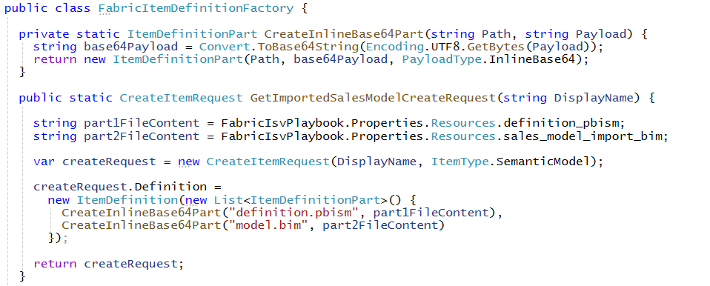
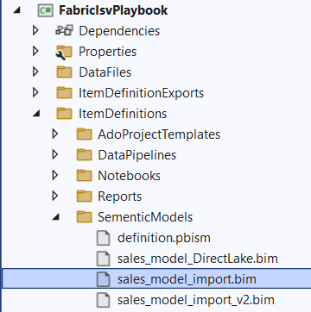
Constructing Item Definitions for the CreateItem API
FabricItemDefinitionFactory class used to build item definitions for calls to CreateItem
Examples provided for semantic models, reports, notebooks and data pipelines
Template files for item definitions maintained in ItemDefinitions folder as embedded resources
The utility method CreateInlineBase64Part converts standard string into Base64 string for inline part
The method GetImportedSalesModelCreateRequest constructs item definition to create semantic model

Slide 36
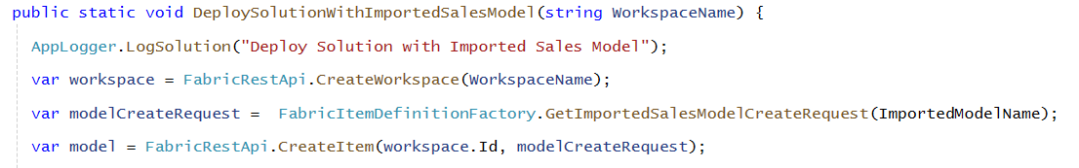
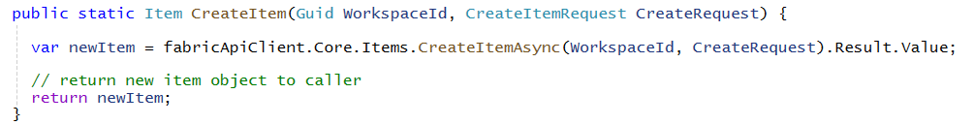
Creating Semantic Model using CreateItem
Call FabricUserApi.CreateItem passing FabricItemCreateRequest instance
CreateItem method calls CreateItem API using Core.Items client from .NETSDK

Slide 37
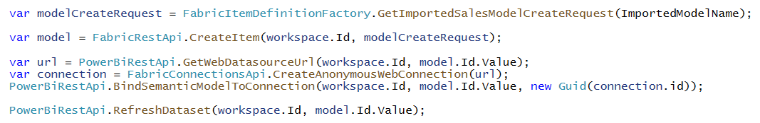
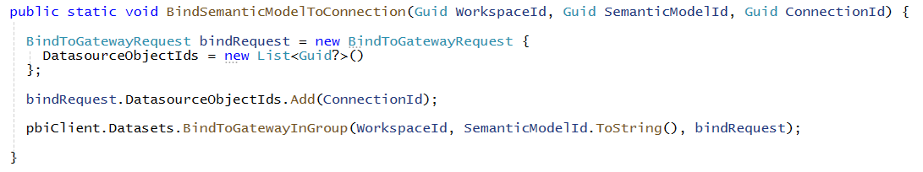
Preparing the Semantic Model After Creation
Imported semantic model needs to be refreshed after creating from item definition
Call to CreateItem creates semantic model instance but does not populate semantic model with data
Currently, Power BI REST API required to bind connection and refresh semantic model
Developer binds semantic model to connection using BindToGatewayInGroup API
In the fullness of time, this binding and refresh functionality will be added to the Fabric REST API

Slide 38
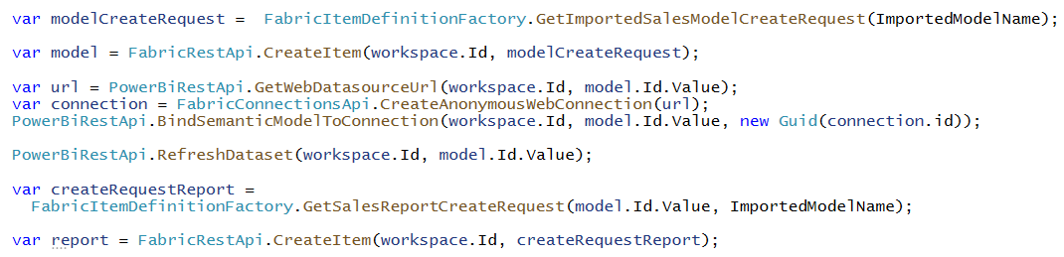
Binding Reports to Semantic Models
When creating report from item definition, you must bind report to semantic model
Report definition is maintained in report.json while definition.pbir only binds report to semantic model
Report definition has dependencies on names of tables, columns and measures in semantic model
Report has no dependencies on the type of underlying semantic model
Shared report definition can be bound to import-model semantic models and DirectLake semantic models
When you create a new report, you need to bind it to a target semantic model
When you create a new semantic model, you need to capture item Id returned from Create Item
When creating the item definition for the report, you use item Id for semantic model for binding
Capture model object
Pass model.id when creating item definition for report

Slide 39


Creating Report using CreateItem API
Creating report requires item definition with the following parts
definition.pbir –file containing metadata for Id of target semantic model
report.json – file containing report layout with pages and visuals
CY24su02.json –Power BI Desktop report theme file

Slide 40



Demo 3 - Imported Semantic Model and Reports
This is the classic Power BI provision flow
Create semantic model by calling CreateItem with item definition
Create Web Connection (Fabric Connections API)
Bind Connection and Refresh semantic model (Power BI REST API)
Create report(s) by calling CreateItem with item definition which contains semantic model Id
Custom ISV Application
Customer Tenant Workspace
Semantic Model
report
Create Semantic Model
Create Connection
report
Refresh Semantic Model
Create Report
Imported Data
Web Connection

Slide 41

Demo 3 Output

Slide 42



Exporting Existing Items using Get Item Definition
Get Item Definition API allows you retrieve item definition for existing items
Call Get Items to discover set of item Ids in workspace then call Get Item Definition once for each item Id
Make it possible to create a folder on local file system with set of files for each item definition part
Exported items definitions used to reverse engineering item definition parts needed for calling CreateItem
Your Application
Fabric REST APIs
Item Definition
for Report
GET - Get Item Definition
Item Definition
for Semantic Model
GET - Get Item Definition

Slide 43
Updating Workspace Items using Update Item Definition
Use Update Item Definition API to update semantic models and reports
You can update semantic models and reports completely independent of one another
Your Application
Fabric REST APIs
Item
Definition
POST - Update Item Definition

Slide 44

Creating Item Definition to Update Semantic Model
Use the same item definition passed to CreateItem with updated model.bim
Updated BIM file

Slide 45


Updating a Semantic Model
Get item definition with updated model.bim
Call UpdateItemDefinition API using .NET SDK
Your Application
POST https://api.fabric.microsoft.com/v1/workspaces/{WORKSPACE_ID}/items/{ITEM_ID}/updateDefinition
Fabric REST APIs

Slide 46

Creating Item Definition to Update Report
Version 2 of report has updated layout and uses new built-in theme
Updated report content for layout maintained in sales_report_v2_json resource
Report update includes adding new built-in theme named NewExecutive.json
Updated report.json file
Extend report with new built-in theme

Slide 47


Updating a Report
Your Application
POST https://api.fabric.microsoft.com/v1/workspaces/{WORKSPACE_ID}/items/{ITEM_ID}/updateDefinition
Fabric REST APIs

Slide 48


Updated Semantic Model and Report

Slide 49
Cloning Workspace
Fabric REST API makes it possible to clone workspaces
Enumerate through all items in source workspace using ListItems
Read item definitions from source workspace using GetItemDefinition
When required, update item definition of source item
Create items in clone workspace using CreateItem
Your Application
Source Workspace
Source
Definition
Item
Definition
GET - Get Item Definition
update
Item
definition
Clone Workspace
Updated
Definition
Item
Definition
POST - Create Item

Slide 50

Cloning Semantic Models
Steps to cloning semantic models
Create and bind connections
Refresh import-mode semantic models
Create dictionary with semantic model Ids for reports to redirect from source workspace to clone workspace

Slide 51


Cloning Reports with Semantic Model Id Substitution
Report item definitions require update
You must substitute semantic model Ids to reference semantic models in clone workspace
UpdateItemDefinitionPart utility method performs search and replace on text inside part file

Slide 52
Workshop Agenda
Solution Deployment using the Fabric REST API
Automating Solution Deployment across Fabric Workloads
Getting Started with the Fabric CI/CD
Fabric Data Warehouse CI/CD using IDE

Slide 53
Automating Solution Deployment across Fabric Workloads
Deploying solutions with lakehouses and notebooks
Deploying solutions with warehouses and data pipelines
Deploying solutions with shortcuts the LoadTable API
Deploying solutions with warehouse and SqlClient
Deploying solutions using ADLS Gen2 APIs

Slide 54

Fabric Lakehouse Fundamentals
Lakehouse used to store structured data and unstructured data in a single location
Lakehouse data transparently stored in OneLake using Azure Data Lake Storage Gen2 (ADLS Gen2)
Lakehouse data accessible across workloads like data engineering, data warehouse, data science & BI
Lakehouse enables storing and refining data using medallion architecture (bronze>silver>gold)
Lakehouse structure
Tables section used to store structure data in tables in Delta format
Files section used to store unstructured data as files

Slide 55
Ingesting Data into Lakehouse
Running Spark jobs
Running notebooks
Running Spark Job Definitions
Running Data Pipelines
Running data pipelines with activities to copy data from external sources
Creating Shortcuts
Creating references to make files from an external source appear to be in lakehouse storage
Using ADLS Gen2 APIs
Implemented by client application which uploads files into lakehouse storage using push approach
Running Fabric Gen2 Dataflows (still waiting on APIs ☹ )
Running a dataflow which imports data and saves it delta tables in lakehouse storage

Slide 56
Fabric Provides Apache Spark Runtime
Spark is a unified engine for large-scale data analytics
Spark code can be executed through Spark Job Definition
Spark code can be executed using interactive Fabric Notebook
Apache Spark provides APIs to read and write data to/from Lakehouse in OneLake
Spark supports several languages such as Python, Scala, SQL and R
Microsoft Fabric
Spark Job Definition
Apache Spark
Lakehouse
Python Runtime
Notebook

Slide 57






Using Spark Jobs to Create Lakehouse Tables
Custom ISV Application
Customer Tenant Workspace
Environment
Lakehouse
bronze layer
silver layer
gold layer
notebook
Spark job
Spark job
Spark job

Slide 58



Creating Lakehouse using Create Item
Lakehouse created without item definition – you only pass displayName and type
Response from Create Item includes lakehouse id which is required to create notebooks
Code used in developer sample application to create lakehouse

Slide 59

Code Walkthrough of Python Code in Notebook
Steps to provisioning flow which builds out medallion architecture
Create bronze layer by coping CSV files into Files section
Create silver layer by loading CSV data into dataframes and saving them as delta tables with OLTP schema
Create gold layer by transforming data from silver tables into delta tables with star schema

Slide 60

CreateLakehouseTables.ipynb
Notebook created calling CreateItem with notebook part CreateLakehouseTables.ipynb
Notebook code and all other content stored in single JSON file with ipynb extension
Note: Fabric also supports calling CreateItem with standard Python file with py extension

Slide 61


Create Item Definition Part for Notebook
Notebook item template is .ipynb file containing placeholders
Placeholders used to substitute Ids for workspace and lakehouse
This substitution technique required to bind new notebook to existing lakehouse
Notebook Part Template with Placeholders
Notebook Part Instance passed to Create Item API
After Substitution

Slide 62



Creating Notebook using CreateItem
When creating item definition for notebook, set item definition format to ipynb
The demo flow creates notebook using CreateItem, then calls FabricUserApi.RunNotebook

Slide 63

Running Notebook with Job Scheduler API
Job Scheduler provides generic, on-demand execution API for runnable Fabric Items
Used to run Notebook, Spark Job Definition, Data Pipeline or Table Maintenance Operation
Running notebook on demand using Job Scheduler

Slide 64

Lakehouse Properties
Retrieve lakehouse properties by executing GET request through /lakehouses endpoint
GET request with target URL of /workspaces/{WORKSPACE_ID}/lakehouses/{LAKEHOUSE_ID}
JSON response provides sqlEndpointProperties data required to create semantic model
SQL Connection Info

Slide 65
Creating Semantic Models on Lakehouse Tables
Creating semantic model on lakehouse tables uses DirectLake mode
Semantic model created by passing model.bim to Create Item API
Semantic model allow you to define relationships, measures, hierarchies, etc.
CAVEAT: DirectLake semantic models do not support many import-mode features
Customer Tenant Workspace
Lakehouse
Semantic Model (aka Dataset)
SQL Endpoint

Slide 66


Creating BIM File for DirectLake Semantic Model
Add DatabaseQuery expression which defines connection to SQL endpoint
Reference DatabaseQuery as expressionSource in partition for each table definition

Slide 67


Creating DirectLake Semantic Model using CreateItem
Create item definition using BIM file updated with SQL endpoint information
Create semantic model using CreateItem then patch credentials and refresh

Slide 68


Demo 4 - Create Lakehouse, Notebook and DirectLake Model
Custom ISV Application
Customer Tenant Workspace
Lakehouse - Sales
Semantic Model
Gold layer
report
Run Python Notebook
SQL Endpoint
report
Lakehouse - Staging
Silver layer
Run Python Notebook
bronze layer
Run Python Notebook
External Data Files

Slide 69



Demo04 Output

Slide 70
Fabric Data Warehouse Fundamentals
What are the similarities between a Lakehouse and a Warehouse
They expose delta tables (structured data) to consumers through a SQL endpoint
Their SQL endpoint can serve as datasource for a DirectLake semantic model
What's the advantage of a Lakehouse over a Warehouse?
Lakehouse has Files section to store unstructured data
Lakehouse storage accessible to Notebooks and Spark Job Definitions that use Spark APIs
Lakehouse provides a platform to run heavily-computational processes for machine learning and AI
What's the advantage of a Warehouse over a Lakehouse ?
Warehouse has SQL endpoint that is read-write
Creating tables and adding rows to warehouse accomplished by executing SQL statements
Warehouse provides transactional operations while lakehouse does not
Warehouse serves as a SQL MPP Engine (massively parallel processing engine)

Slide 71





Creating a New Data Pipeline by Hand
Step to create a new data pipeline
Add Copy data activity and select a datasource

Slide 72








Authoring Data Pipelines by Hand

Slide 73


CopySalesData.json
CreateDataPipeline has data pipeline template for named CopySalesData.json
Template file has substitution placeholders for {CONNECTION_ID}, {WORKSPACE_ID} and {LAKEHOUSE_ID}

Slide 74
Demo 5 - Create Warehouse using Data Pipelines
Custom ISV Application
Customer Tenant Workspace
Create Warehouse
Warehouse - Sales
Semantic Model
Gold layer
report
Create/Run Data Pipelines
Create tables
Create stored procedures
Refresh all tables
SQL Endpoint
report
Lakehouse - Staging
Silver layer
Create Lakehouse
Create/Run Data Pipeline
load lakehouse tables
External Data Files

Slide 75



Demo05 - Create Tenant with Warehouse and Data Pipelines

Slide 76


OneLake Shortcut Fundamentals
What is a OneLake shortcut?
A shortcut is an OneLake object that points to another internal or external storage locations
Shortcuts can be created in lakehouses and Kusto Query Language (KQL) databases
OneLake supports shortcuts targeting external locations in ADLS storage, Amazon S3 storage and Dataverse
Shortcuts behave like symbolic links
Shortcuts are independent objects from the target source
If you delete a shortcut, the target remains unaffected
If you move, rename, or delete a target path, the shortcut can break
Shortcut acts as pointer to storage location
Shortcut has unique icons

Slide 77








Creating Shortcuts by Hand

Slide 78

Inspecting Shortcuts using Get Shortcuts API
You can inspect shortcuts in a lakehouse using Get Shortcuts API
/workspaces/{WORKSPACE_ID}/items/{LAKEHOUSE_ID}/shortcuts
Returns JSON result with target properties for source such as oneLake or adlsGen2
Inspecting JSON allow you to reverse engineer shortcuts created by hand
You can also capture connectionId from connections created by hand

Slide 79



Creating Shortcut to ADLS Gen2 Storage
Creating shortcut to folder in ADLS Gen2 storage container
You can now access files in shortcut folder as if they were native to this lakehouse

Slide 80

Creating Lakehouse Shortcuts with Code
Creating shortcut to folder in ADLS Gen2 storage container
You can now access files in shortcut folder as if they were native to this lakehouse

Slide 81

Demo06 - Create Tenant with Shortcut and LoadTable API
Custom ISV Application
Customer Tenant Workspace
Warehouse - Sales
Semantic Model
Gold layer
report
Create & Run the same
Data Pipelines as Demo04
SQL Endpoint
report
Lakehouse - Staging
Silver layer
Fabric LoadTable API
bronze layer
Create Shortcut API

Slide 82


Demo06 Output

Slide 83

Demo07 uses SqlConnectionWriter Class
FabricIsvPlaybook project includes custom SqlConnectionWriter class
Abstracts away code to establish connection to SQL endpoint and execute SQL statements
Uses classes from Microsoft.Data.SqlClient including SqlConnection and SqlCommand
Calls EntraIdTokenManager.GetAccessTokenForSqlEndPoint to acquire access token to access SQL endpoint

Slide 84

Create Warehouse and Establishing SQL Connection
High-level steps for building out data warehouse
Create data warehouse
Get connection info for SQL endpoint
Establish connection to SQL endpoint and execute SQL statements

Slide 85
The SqlConnectionWriter Class
Demo5-CreateWarehouse projects includes custom SqlConnectionWriter class
Abstracts away code to establish connection to SQL endpoint and execute SQL statements
Uses classes from Microsoft.Data.SqlClient including SqlConnection and SqlCommand
Calls AzureAdTokenManager.GetAccessTokenForSqlEndPoint to acquire access token to access SQL endpoint

Slide 86

GetAccessTokenForSqlEndPoint
AzureAdTokenManager class contain GetAccessTokenForSqlEndPoint method
Authenticates with special application Id used by Microsoft.Data.SqlClient package
Acquires access token with SQL-specific delegated permission https://database.windows.net//.default
This is really funky. You must pass two forward slashes instead of one slash
Passing //.default works
Passing /.default does not work

Slide 87


Populate Warehouse by Creating Stored Procedures
ISV application begins by executing SQL commands to create stored procedures
Custom ISV Application
SQL Commands

Slide 88




Populating Warehouse Tables from Lakehouse Tables
SQL INSERT INTO commands used to populate warehouse tables
SQL command uses SELECT FROM staging.dbo.table_name to pull from lakehouse tables
SQL used to transform and reshape data from normalized OLTP schema into star schema
SQL logic used to build calendar table

Slide 89

Demo07 - Create Tenant with Warehouse and SqlClient
Custom ISV Application
Customer Tenant Workspace
Warehouse - Sales
Semantic Model
Gold layer
report
Execute SQL using SqlClient
Create tables
Create stored procedures
Refresh all tables
SQL Endpoint
report
Lakehouse - Staging
Silver layer
Fabric LoadTable API
bronze layer
Create Shortcut API

Slide 90


Demo07 Output

Slide 91

ADLS Gen2 API Fundamentals
ADLS Gen2 APIs
Microsoft's primary REST APIs for interacting with Azure Blog storage and Azure Data Lake storage
ADLS Gen2 APIs can be used for uploading, downloading and transferring files
Azure Data Lake Storage Gen2 REST APIs Documentation
ADLS Gen2 API .NET SDK
Set of .NET class wrappers which adds a valuable productivity layer when programming in C#
ADLS Gen2 API .NET SDK Documentation
CAVEAT: ADLS Gen2 API documentation does not cover any details specific to OneLake
Some functionality provided by ADLS Gen2 APIs not available when accessing OneLake
Examples of these features includes creating storage containers and programming permissions

Slide 92








Accessing OneLake using Azure Storage Explorer
create new connection

Slide 93

Configuring OneLake in the Fabric Admin Portal
Access to OneLake using ADLS Gen2 APIs can be enabled/disabled
These settings must be enabled to successfully access to OneLake storage
They are enabled by default but can be disabled by Fabric Administrator

Slide 94
Accessing OneLake using ADLS Gen2 APIs
All access to Azure storage for OneLake accessible through a single URL
Base URL for Fabric public cloud is https://onelake.dfs.fabric.microsoft.com
Base URL for OneLake will be different when accessing other Microsoft clouds
Access lakehouse storage using name of workspace and name of lakehouse/warehouse
https://onelake.dfs.fabric.microsoft.com/{WORKSPACE_NAME}/{ITEM_NAME}.{ITEM_TYPE}/{FILE_PATH}/{FILE_NAME}
Access lakehouse storage using Id of workspace and Id of item
Using IDs instead of names is much less problematic
https://onelake.dfs.fabric.microsoft.com/{WORKSPACE_ID}/{ITEM_ID}/{FILE_PATH}/{FILE_NAME}
OneLake also supports the Azure Blob Filesystem driver (ABFS)
abfss://{WORKSPACE_ID}@onelake.dfs.fabric.microsoft.com/{ITEM_ID}/{FILE_PATH}/{FILE_NAME}

Slide 95

Code Walkthrough of OneLakeTokenCredentials Class
The OneLakeFileWriter class relies on utility class named OneLakeTokenCredential
TokenCredential used to acquire access token with delegated permission for Azure storage
The delegated permissions required for OneLake access is https://storage.azure.com/user_impersonation

Slide 96

Walkthrough of OneLakeFileWriter Class

Slide 97
ISV Flow using ADLS GEN2 APIs and Load Table API
New integration flow to populate delta tables from uploaded data files
ADLS Gen2 API used to upload CSV and/or PARQUET files to Files section in lakehouse
Tables – Load Table API used to load delta table from data file
Customer Tenant Workspace
Lakehouse
Custom ISV Application
Files section
Tables section
ADLS Gen2 API
Tables – Load Table API

Slide 98

Demo08 - Create Tenant with ADLS Gen2 API
Custom ISV Application
Customer Tenant Workspace
Warehouse - Sales
Semantic Model
Gold layer
report
SQL Commands
SQL Endpoint
report
Lakehouse - Staging
Silver layer
Tables –Load Table
bronze layer
ALDLS Gen2 API

Slide 99

Demo08 Output

Slide 100
Workshop Agenda
Solution Deployment using the Fabric REST API
Automating Solution Deployment across Fabric Workloads
Getting Started with the Fabric CI/CD
Fabric Data Warehouse CI/CD using IDE

Slide 101



Native CI/CD Platform Features
Built-in git integration
Deployment pipelines
Fabric REST API
GA feature (with ADO & GitHub)
GA feature
GA Feature
101
Microsoft Fabric
Notes:
Talk about CI and CD options that is availaible

Slide 102

Continuous Integration – GIT Integration Concepts
Avaliablea as Workspace Setting
Supports multiple GIT Providers
Rich UX for No-Code experience
Multiple options for Branching
Items strored in Native format
Automation with Fabric GIT APIs
Item | GIT Support
Power BI reports
Power BI paginated reports
Power BI Semantic models
Notebooks
LakeHouse
Item | GIT Support
Data pipelines
Data Warehouse
Spark Job definition
Spark Environment
102
Microsoft Fabric
Notes:
Talk about selective commit , changes as part of roadmap
Mention irreversible nature of workspace update from GIT

Slide 103
Continuous Integration – GIT Integration Concepts
DEMO

Slide 104



Continuous Integration – Managing Branches
Branch out to new workspace –
Create a new isolated work environment (workspace & branch) in a few clicks.
After clicking ‘Create’:
New workspace is created and assigned to a capacity
New branch is created, based on existing branch
New branch and workspace are connected
Branch content is synced into the workspace
Developer lands in new workspace, reducing ‘time-to-code’.
Contextual Navigation & Branches Tab
Find other branches and navigate to their respective workspaces.
Contextual list of the same ‘branch workspaces’.
104
Microsoft Fabric
Notes:
Talk about selective commit , changes as part of roadmap
Mention irreversible nature of workspace update from GIT

Slide 105



Continuous Integration – Managing Branches
Switch Branch
Enables developers to switch & sync existing workspace to a different GIT branch
Prompts in case uncommitted items
Ability to create new Devops branch from existing branch
Checkout Branch
Creates new branch & connect workspace to it
Uploads all the supported items to new branch
Useful to resolve Conflict
105
Microsoft Fabric
Notes:
Talk about selective commit , changes as part of roadmap
Mention irreversible nature of workspace update from GIT

Slide 106
Continuous Integration – Fabric GIT APIs
Connect | Connect a specific workspace to a git repository and branch.
Disconnect | Disconnect a specific workspace from the Git repository and branch it is connected to.
Initialize Connection | Initialize a connection for a workspace that is connected to Git.
Get Connection | Returns git connection details for the specified workspace.
Commit To Git | Commits the changes made in the workspace to the connected remote branch.
Get Status | Returns the Git status of items in the workspace, that can be committed to Git.
Update From Git | Updates the workspace with commits pushed to the connected branch. ConflictResolutionPolicy helps to determine which way to sync: GIT->Workspace or Workspace->GIT
106
Microsoft Fabric
Notes:
Talk about selective commit , changes as part of roadmap
Mention irreversible nature of workspace update from GIT

Slide 107

Continuous Integration : Development Workflow
1
Setting up Dev Workspace: The project lead sets up a Main workspace' and connects it to the "main branch“ if not already done
PR & Merge: Once a developer completes work & commit on a feature branch, they initiate a pull request to merge it into the main branch
Build Pipeline: Upon the completion of a PR, a DevOps pipeline triggered to sync updated items from GIT->Workspace & manage dependencies
Setting up Feature Workspaces: Developers creates feature workspaces mapped to feature branches using one of available options ( UX or code)
Switch Branch: It is recommended that developers do not delete their workspaces after completing a feature branch pull request
2
3
4

Slide 108
Demo – Multiple Developers Working In A Project
Jessy sets up the development workspace connected to development branch
Team creates feature workspaces by leveraging “Branch out” option from the Dev workspace, connecting to their respective feature branches
Team works in their feature workspaces and commits changes to feature branches
Team raises PR which Jessy reviews & merge to Dev branch
Build pipeline synchronizes changed items from Dev branch to Dev workspaces
Person | Role
Jessy | Team Lead
Alex | Data Integration Developer
Sam | Data Warehouse Developer
Tom | Data Engineering Developer
Workspace Name | Capacity | Workspace Admin | Branch | Roles
Dev Workspace | Main dev | Jessy | Main_branch | Developers: Viewer
Alex_feature1_ws | Shared Capacity | Alex | Alex_feature_1_branch | Jessy: Contributor
Sam_feature2_ws | Shared Capacity | Sam | Sam_feature_1_branch | Jessy: Contributor
Tom_feature3_ws | Shared Capacity | Tom | Tom_feature_1_branch | Jessy: Contributor
108
Notes:
Recommendation:
Each developer works on their own feature workspace.
Commit changes to the feature branch isolated from the main branch and main workspace.
Ensure changes do not interfere with others' work.
Request a Pull Request to merge the feature branch into the main branch, initiating a code review process.
Ensure approval before integration.
The Azure pipeline uses the Git- Update From Git APIs to sync the main branch and the main workspace.

Slide 109
Continuous Integration – Demo GIT Integration
DEMO
109
Microsoft Fabric

Slide 110

Continuous Delivery - Fabric Deployment Pipeline
Native & No-Code deployment
Apply rules on configuration like default lakehouse
Compare changes on code-level
Create a pipeline of 2-10 stages
Supports REST APIs for automation
Item | DP Support
Power BI reports
Power BI paginated reports
Power BI Semantic models
Notebooks
LakeHouse
Item | DP Support
Data pipelines
Data Warehouse
Spark Job definition
Spark Environment
110
Microsoft Fabric

Slide 111

Continuous Delivery - Fabric APIs : GIT & Items API
Automated operations on behalf of Fabric users.
Supported scenarios:
Item management (see table)
Item definition
Workspace management
Workspace access management
Execute item jobs
Automation using Fabric GIT API
111
Microsoft Fabric

Slide 112
Continuous Delivery - Decision Tree
Continuous Delivery
Fabric Deployment Pipeline
Intuitive UX Driven & No Code solution
Inbuilt Permission & deployment history
REST API for DevOps tools
Fabric GIT
GIT to be source of truth
Pro-Dev
REST API for automation
UX based Interaction
Fabric Items APIs
Flexible for complex scenarios
Supports multiple Code repositories & DevOps tool
Robust REST API support
Multi-Tenant support
UX Driven?
Yes
Fabric Deployment Pipeline
No
GIT Driven
?
Yes
Fabric Git: Update API
No
Fabric Items API
Fabric Deployment Pipeline API
112
Microsoft Fabric
Notes:
Call out SPN support is planned

Slide 113

Continuous Delivery : Fabric Deployment Pipeline Driven
Deploy to Test / Prod via Deployment Pipeline
Rick UX
Define rules to manage dependencies eg: default lakehouse
Selective Deployment
Orchestrate from Azure DevOps through Deployment APIs
113
Microsoft Fabric

Slide 114

Continuous Delivery - Fabric Deployment Pipeline
114
Microsoft Fabric

Slide 115

Continuous Delivery : Fabric GIT API Driven
Git serves as ‘single source of truth’, and all deployments originates from repo.
Using primary branches for each stage
PR to each stage branches
Fabric Git APIs to update workspace in each stage
115
Microsoft Fabric
Notes:
Consideration:
Utilize GIT as the single source of truth for all deployment and delivery processes.
Each workspace (Dev, Test, UAT, etc., Prod) should be linked to a distinct GIT branch.
Workspace-specific attributes such as Lakehouse Id, connection Id, notebook binding, etc., can be managed as post-deployment tasks by leveraging Fabric Item APIs.

Slide 116
Continuous Integration – Fabric GIT API Driven
DEMO
116
Microsoft Fabric

Slide 117

Continuous Delivery : Fabric Item API based
Git connected to Dev
Run Build pipelines for Unit testing.
Run Release pipelines for change configurations, and
Upload using Fabric APIs to ‘Create/Update item definition’
117
Microsoft Fabric

Slide 118
Workshop Agenda
Solution Deployment using the Fabric REST API
Automating Solution Deployment across Fabric Workloads
Getting Started with the Fabric CI/CD
Fabric Data Warehouse CI/CD using IDE

Slide 119
CI/CD with Warehouses in Microsoft Fabric
Build warehousing solutions – from code integration to code deployment
Git Integration & Deployment Pipelines: Seamlessly integrate development processes and automate deployment of schema changes.
SQL Database Projects: Leverage DACPAC and SQLPackage for schema changes across environments
Fabric Git APIs : Utilize Fabric GIT APIs to create automated workflows and pipelines that ensure quality, reliability, and productivity for data projects
CI/CD with Fabric Warehouses
UX Driven?
GIT Driven?
Fabric Deployment pipeline
Yes
Yes
No
Yes
Developer Tools?
Fabric GIT APIs
Yes
Database Project and SQL Package

Slide 120







Scenario 1: Basic CI/CD process with Fabric Workspace and Deployment pipeline
Fabric
Deploy
Deploy
…
Dev Workspaces
(collabration)
Test Workspaces
Prod Workspaces
Feature Workspaces
Commit/undo/ update
Deployment Pipeline
Notes:
Pro devs can:
Have a single source of truth
Use Git for collaboration
Release automatically using Azure Pipelines/ GitHub Actions
Leverage following pipelines capabilities:
Serve as ‘build’ environment
Validation of deployment
Retain connections
Apply rules
Deployment audit

Slide 121

Video for this demo is CICD_WAREHOUSE_DEMO01.mp4
Notes:
value prop here is that it allows you to compare schemas across stages, allows you to create initial definition in dev and test it across different environments to make sure it works before hitting prod and exposing it to end users, etc
Time: 6 mins

Slide 122




Scenario 2: Basic CI/CD process with Developer tool and SQL Database Project
Fabric
Development process
Dev DW
DACPAC
Deploy
Test Approval workflow
Feature
Main
Test DW
Prod Approval workflow
Prod DW
Build and Release Pipeline

Slide 123

Video for this demo is CICD_WAREHOUSE_DEMO01.mp4

Slide 124
Workshop Summary
Solution Deployment using the Fabric REST API
Automating Solution Deployment across Fabric Workloads
Getting Started with the Fabric CI/CD
Fabric Data Warehouse CI/CD using IDE

Slide 125

Quick Links to Workshop Material
GitHub: https://aka.ms/FabConWorkshop
Slides: https://aka.ms/FabConWorkshopSlides
Download: https://aka.ms/FabConWorkshopDownload

Slide 126

Quick Links to Workshop Material
GitHub: https://aka.ms/FabConWorkshop
Slides: https://aka.ms/FabConWorkshopSlides
Download: https://aka.ms/FabConWorkshopDownload

Slide 127


